Slide 1
LIS in All Substrings
報告人：曾球庭
日期：94/09/16

Slide 2
LIS
Longest Increasing Subsequence, ex. LIS of 35274816 is 3578.
LIS may not be unique, ex. LIS of 456123 can be 456 or 123.

Slide 3
LIS in Sliding Windows
Longest Increasing Subsequences in Sliding Windows. Theoretical Computer Science 321 (2004) 405–414
Find an LIS for all sliding windows (fix length).
O(nloglogn + nl)

Slide 4
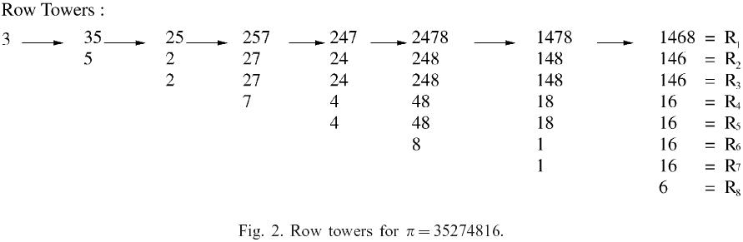
Row tower(1)
Input string=35274816

Slide 5
Row Tower(2)
Input string：35274816

Slide 6
Row Tower(3)
A naïve implementation of the data structure using a van Emde Boas priority queue for each row takes O(1) time for expiring, O(wloglogn) time for adding each element and O(1) time for outputting the length of each subsequence. Total time complexity would be O(nwloglogn), space complexity O(nw).

Slide 7
Data structure(1)
d sequence：used to record the valid range of every element.
σsequence：used to record the sequence of expiration.
Principle row：used to record the LIS of the entire substring.
m sequence：number of duplicate rows.

Slide 8
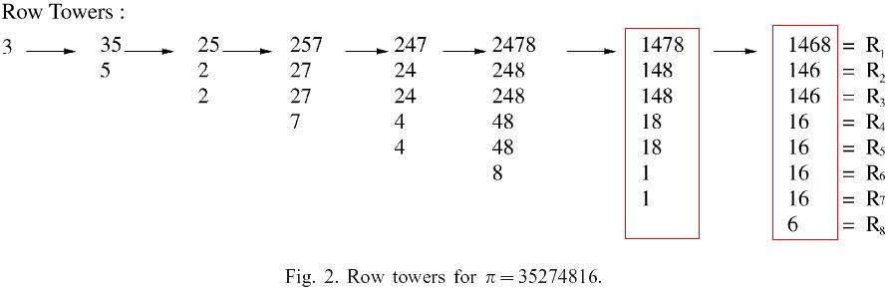
Data Structure(2)
PR = (1,4,6,8)
m = (1,2,4,1)
d = (7,3,8,1)
σ= (3,2,4,1)
PR = (1,4,7,8)
m = (1,2,2,2)
d = (7,3,1,5)
σ= (4,2,1,3)

Slide 9
Add
i_{t+1} is the least index larger than i_{t} for which d(i_{t+1})>d(i_{t} ), the sequence d is updated according to:
d(i_{t+1}) = d(i_{t}) for t = 1,2… k-1, (means “shift”)
d(i₁) = w + 1:
Similarly, the update of σ is
σ(i_{t+1}) = σ(i_{t}) for t = 1,2…k-1, (also means “shift”)
σ(i₁) = l
→ This operation cost O(l), where l is the length of LIS in the processing window

Slide 10
Example(1)
Input Sequence=35274816
d=(1)
σ=(1)
d=(1,2)
σ=(1,2)
d=(3,1)
σ=(2,1)
d=(3,1,4)
σ=(2,1,3)
d=(3,5,1)
σ=(2,3,1)

Slide 11
Example(2)
Input sequence：35274816
d=(3,5.1)
σ=(2,3,1)
d=(3,5,1,6)
σ=(2,3,1,4)
d=(7,3,1,5)
σ=(4,2,1,3)
d=(7,3,8,1)
σ=(3,2,4,1)

Slide 12
Expire
The expire operation simply subtracts 1 from each element of d and deletes the element with expiry time 0 (if there is one) from R. If no deletion occurs then σ is unchanged. Otherwise, the element 1 is deleted from σ and the remaining values are decreased by 1.
→ This operation cost O(l), where l is the length of LIS in the processing window

Slide 13
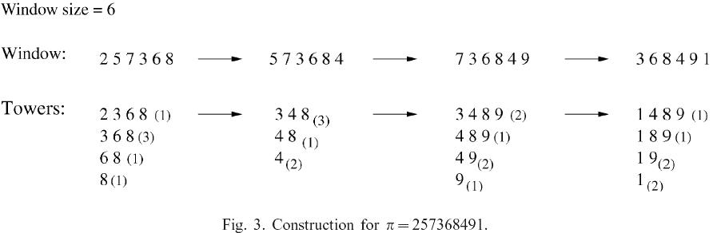
An Example
PR=(2,3,6,8)
m=(1,3,1,1)
d=(1,4,5,6)
σ=(1,2,3,4)
PR=(3,4,8)
m=(3,1,2)
d=(3,6,4)
σ=(1,3,2)
PR=(3,4,8,9)
m=(2,1,2,1)
d=(2,5,3,6)
σ=(1,3,2,4)
PR=(1,4,8,9)
m=(1,1,2,2)
d=(6,1,2,4)
σ=(4,1,2,3)
EXP
ADD
EXP
ADD
EXP
ADD
PR=(3,6,8)
m=(3,1,1)
d=(3,4,5)
σ=(1,2,3)
PR=(3,4,8)
m=(2,1,2)
d=(2,5,3)
σ=(1,3,2)
PR=(3,4,8,9)
m=(1,1,2,1)
d=(1,4,2,5)
σ=(1,3,2,4)
Red numbers will shift during the “ADD” operation, and blue color labels all i₁

Slide 14
Trace Back(1)
At the time that c is added we establish an array whose entry in position c is the parent of v in column c-1.
In column C-σ(p_{i}) its parent will be the right most element p_{i+1} of the principle which satisfies σ(p_{i}) > σ(p_{i+1}), and this will remain its parent through column C- σ(p_{i+1})+1.

Slide 15
Trace Back(2)
Input Sequence=35274816
 | 1 | 2 | 3 | 4 | 5 | 6 | 7 | 8
1 |  | nil | nil | nil | nil |  | nil
2 |  |  |  | 2 | 3 |  | 2
3 |  |  |  |  |  |  | 5
4

Slide 16
Trace Back(3)
Input sequence：35274816
 | 1 | 2 | 3 | 4 | 5 | 6 | 7 | 8
1 | nil | nil | nil | nil | nil | nil | nil | nil
2 |  |  |  | 2 | 3 | 1 | 2 | 4
3 |  |  |  |  |  | 4 | 5 | 4
4 |  |  |  |  |  |  |  | 7

Slide 17
Algorithm
Use van Emde Boas priority queue to record the first window, O(wloglogn).
Use add and expire to move the window, O(l).
Use trace to trace back the sequence when outputting the LIS, O(l).

Slide 18
Observation(1)
1 | 12 | 123 | 1234 | 12345
 | 2 | 23 | 234 | 2345
 |  | 3 | 34 | 345
 |  |  | 4 | 45
 |  |  |  | 5

Slide 19
Observation(2)
1 | 2 | 3 | 4 | 5
12 | 23 | 34 | 45
123 | 234 | 345
1234 | 2345
12345

Slide 20
Observation(3)
n²/2 expire and n add
1 | 2 | 3 | 4 | 5
12 | 23 | 34 | 45
123 | 234 | 345
1234 | 2345
12345

Slide 21
My Method
Problem：Find an LIS for all substrings of a given string.
If we use the previous method we have n kinds of sliding windows, so the total time complexity is O(n²loglogn)
Try to minimize the cost of expire.

Slide 22
Data structure
Link d sequence from small to large, and record the difference.
Ex. d=(7,3,1,5)
d=(7,3,8,1)
1
2
2
2
1
2
4
1

Slide 23
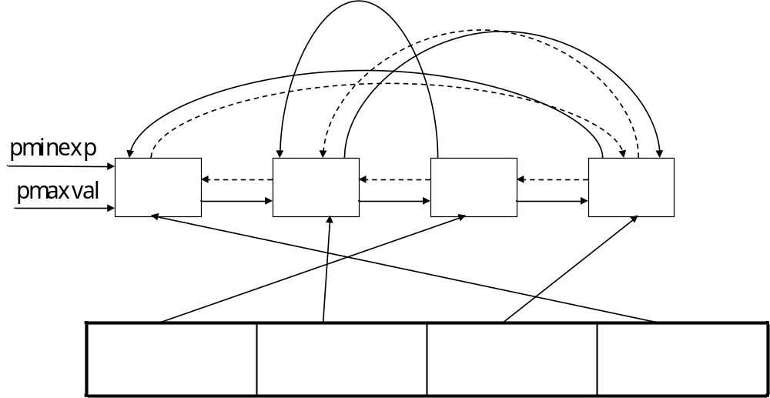
Data Structure
struct snode
{
int deltaexp, val;
snode* nextexp, prevexp;
snode* prevmax, nextmax,
};
snode** lis;
snode * pminexp;
snode* pmaxval;
int** tracetab;
int* dper;
deltaexp, val

Slide 24
Add
Find the place to insert
Update the nodes
Update maxval
Update dper and tracetab

Slide 25
Update Nodes
x
x+t
x+t+u
p,a
q,b
r,c
s,d
t,e
u,f
 | … |  | … |  | … |  | … |  | …
p,a
q,d
r,c
s,e
t+u,f
w+1,g
 | … |  | … |  | … |  | … |  | …

Slide 26
Example
Input string=3
pr=(3), d=(1), σ=(1)
1,3

Slide 27
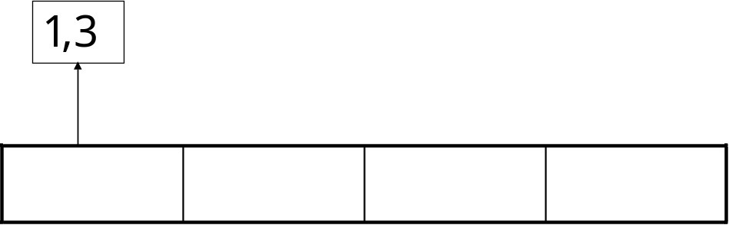
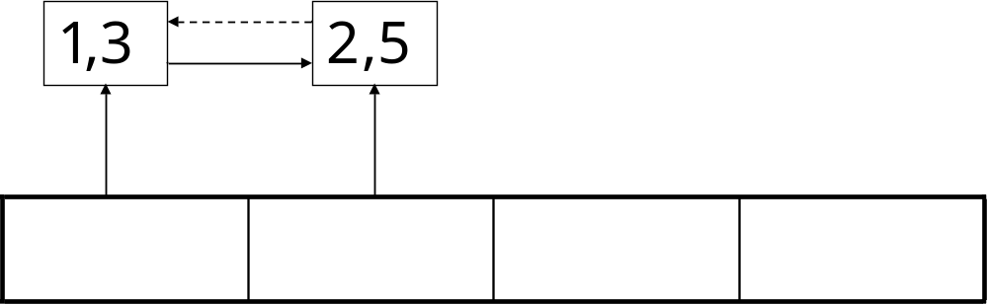
Example
Input 5
pr=(3,5), d=(1,2), σ=(1,2)

Slide 28
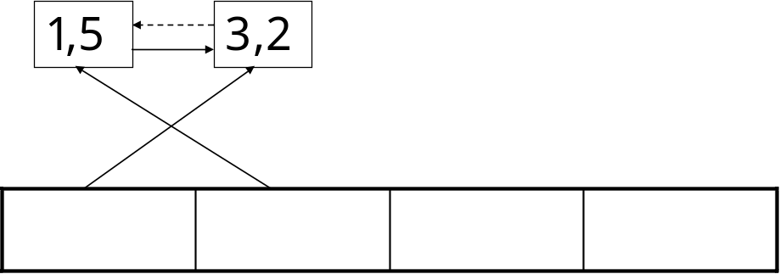
Example
Input 2
pr=(2,5), d=(3,1), σ=(2,1)

Slide 29
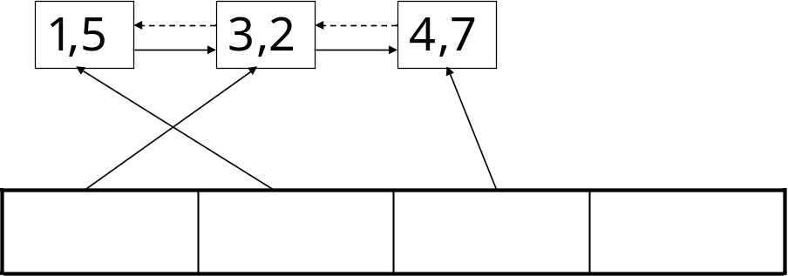
Example
Input 7
pr=(2,5,7), d=(3,1,4), σ=(2,1,3)

Slide 30
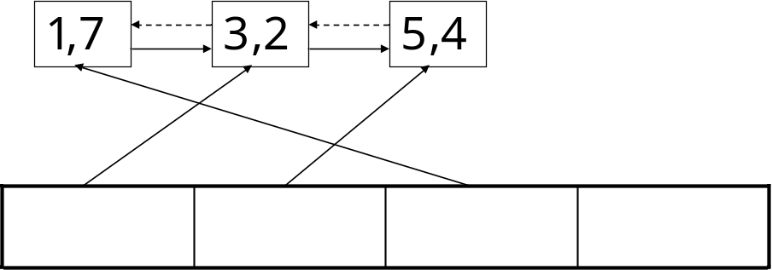
Example
Input 4
pr=(2,4,7), d=(3,5,1), σ=(2,3,1)

Slide 31
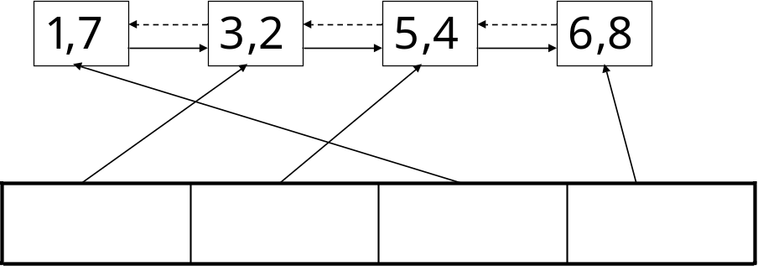
Example
Input 8
pr=(2,4,7,8), d=(3,5,1,6), σ=(2,3,1,4)

Slide 32
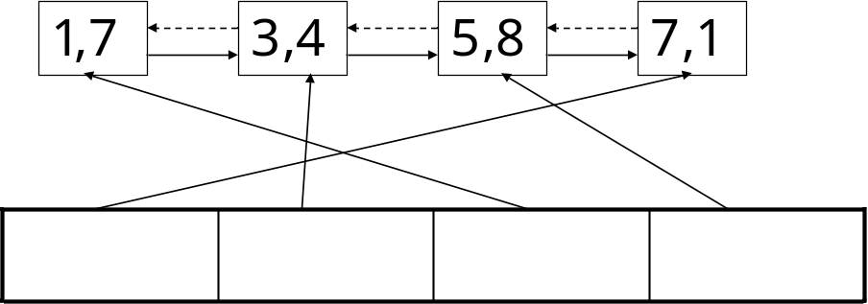
Example
Input 1
pr=(1,4,7,8), d=(7,3,1,5), σ=(4,2,1,3)

Slide 33
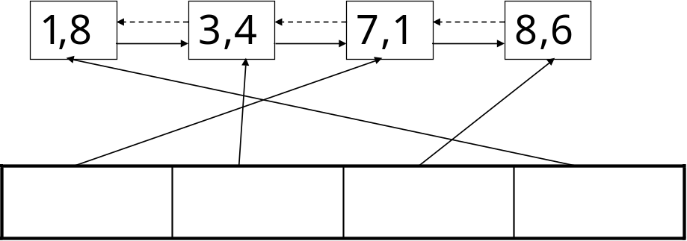
Example
Input 6
pr=(1,4,6,8), d=(7,3,8,1), σ=(3,2,4,1)

Slide 34
Update maxval
If the LIS increases, pmaxval would be different.
Replace the link to/from the moved node.

Slide 35
Update dper
As the original
now=dper[inserted position];
dper[i.p.]=lcsn-1;
for i=0 to lcsn-1
if dper[(i.p.+i)%lcsn]>now
exchange(dpe[(i.p.+i)%lcsn],now)

Slide 36
Update tracetab
As the original
now=dper[inserted position-1];
tracetab[ins][i.p.]=lcs[i.p-1];
ances=lcs[i.p.-1]
for i=i.p.-2 to 0
if dper[i]>now
now=dper[i];
ances=lcs[i];
tracetab[ins][i+1]=ances;

Slide 37
Add
Find the place to insert, O(l )
Update the nodes, O(l )
Update maxval, O(l )
Update dper and tracetab, O(l )

Slide 38
Expire
Decrease minexp by one.
If minexp=0, remove the node pminexp points to, pminexp=pminexp
->nextexp.
If the expired one is pmaxval, pmaxval=pmaxval->nextmax;
else
a
del
b
a
b

Slide 39
Output
now=pmaxval->val;
For i= lcsn – 1 to 1
cout<< now;
now=tracetab[now][i];

Slide 40
Data Structure
struct snode
{
int deltaexp, val;
snode* nextexp, prevexp;
snode* prevmax, nextmax,
};
snode** lis;
snode * pminexp;
snode* pmaxval;
int** tracetab;
int* dper;

Slide 41
Result
We have n adds each O(l ), and O(l )= O(w). So totally O(1+2+…+n)=O(n²)
We have n²/2 expires each O(1). So totally O(n²)

Slide 42

The end

Slide 43
Row tower
The i-th number of the j-th row in the row tower records the number which is the minimum among all LIS of length i in the substring starting from the j-th char.

Slide 44
Add example
d=(9,2,4,5,3,1,7)→ d=(9,2,10,4,3,1,5)
σ=(7,2,4,5,3,1,6)→σ=(6,2,7,4,3,1,5)

Slide 45
Sliding Window
456123
456123

Slide 46
Example
Input string=3
pr=(3), d=(1), σ=(1)
1,3

Slide 47
Example
Input string=35
pr=(3,5), d=(1,2), σ=(1,2)
1,3
2,5

Slide 48
Example
Input string=352
pr=(2,5), d=(3,1), σ=(2,1)
1,5
3,2

Slide 49
Example
Input string=3527
pr=(2,5,7), d=(3,1,4), σ=(2,1,3)
1,5
3,2
4,7

Slide 50
Example
Input string=35274
pr=(2,4,7), d=(3,5,1), σ=(2,3,1)
1,7
3,2
5,4

Slide 51
Example
Input string=352748
pr=(2,4,7,8), d=(3,5,1,6), σ=(2,3,1,4)
1,7
3,2
5,4
6,8

Slide 52
Example
Input string=3527481
pr=(1,4,7,8), d=(7,3,1,5), σ=(4,2,1,3)
1,7
3,4
5,8
7,1

Slide 53
Example
Input string=35274816
pr=(1,4,6,8), d=(7,3,8,1), σ=(3,2,4,1)
1,8
3,4
7,1
8,6

Slide 54
deltaexp val
pminexp
pmaxval

Slide 55
a
del
b
a
b

